Slide 1



CYBER SECURITY INDEX
COMPANY {d.scanInfo.company}
Date: {d.scanInfo.date}
POWERED BY

Slide 2
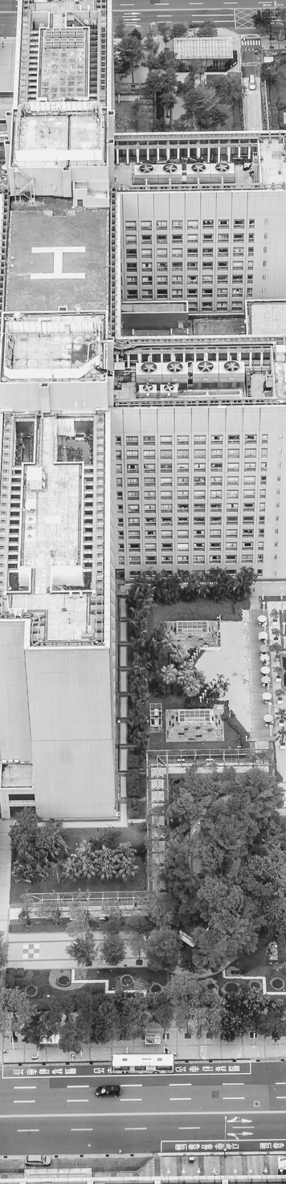

CYBER SECURITY INDEX REPORT
DECEMBER 2020
i
TABLE OF CONTENTS
Executive Summary
Scope
Results
Methodology
Findings
Severity assessments summary
Reconnaissance
Exploitation
01
01
02
03
04
04
05
06

Slide 3
CYBER SECURITY INDEX REPORT
DECEMBER 2020
01
/EXECUTTIVE SUMMARY
EXECUTIVE SUMMARY
Cyber Security Index powered by CMKL is a conducted service where a black-box perspective security assessment, to detect the current vulnerabilities found in the given endpoints and show the level of the current vulnerability severity levels. Our project’s purposes are for the company to be able to continuously access our service for continuous improvement for the company’s security system and gain reputation.
To achieve our goal, we must investigate the vulnerability of our client system’s company. Of the 0 sub-domains identified. A total of {d.index.vulnerabilities.total} unique vulnerabilities were found. The scan inspected the opened {d.nmap.totalPort.tcp} TCP ports and {d.nmap.totalPort.udp} UDP ports.
The following table is the summary of the overall severity test performed on the given endpoints.
Vulnerabilities severity
Unique Count
Critical severity
{d.index.vulnerabilities.details.criticalSeverity}
High severity
{d.index.vulnerabilities.details.highSeverity}
Medium severity
{d.index.vulnerabilities.details.mediumSeverity}
Low severity
{d.index.vulnerabilities.details.lowSeverity}
Scan Information
Start Time: {d.scanInfo.started}
Finish Time: {d.scanInfo.finished}
Scan Duration: {d.scanInfo.duration}
The furthermore details are included on the “finding pages” and in-depth details on the “details pages”

Slide 4
CYBER SECURITY INDEX REPORT
DECEMBER 2020
02
/SCOPE
Scope
END POINTS
{d.scanInfo.endpoints[i].name}
{d.scanInfo.endpoints[i+1].name}
This test scope is engaged on only a black-box perspective(zero-knowledge) with a blind security assessment test on the network area. Testing was performed on {d.scanInfo.date} with industry-standard tools and frameworks, including DNSmap, Nmap, Drib, and Argo.

Slide 5
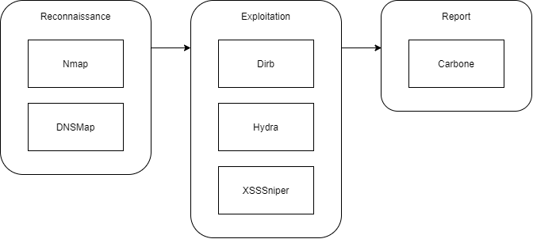
CYBER SECURITY INDEX REPORT
DECEMBER 2020
03
/METHLOGY
METHODOLOGY
As the starting point, the black-box or blinded scan was performed on the provided target server with following these steps:
Reconnaissance
Exploitation
Report
Retrieve information from it by using Nmap, for protocols, and DNSMap, for the subdomain. Exploitation or search vulnerabilities in the system including find directory, brute force list of usernames and passwords.
.

Slide 6
CYBER SECURITY INDEX REPORT
DECEMBER 2020
04
/FINDINGS
FINDINGS
Port and Protocol Found
IP Address | Hostname | Protocol / Port
{d.nmap.endpoints[i].address} | {d.nmap.endpoints[i].hostname} | {d.nmap.endpoints[i].protocols[i].name}
 |  | {d.nmap.endpoints[i].protocols[i+1].name}
{d.nmap.endpoints[i+1].address}
Severity assessments summary
This table below expresses every sub-domains and IPs that were scanned and defined along with founding severity in each of them, classified as critical, high, medium, and low severity.
IP Address | Hostname | Critical Severity | High Severity | Medium Severity | Low Severity
{d.nmap.endpoints[i].address} | {d.nmap.endpoints[i].hostname} | - | - | - | -
{d.nmap.endpoints[i+1].address}

Slide 7
CYBER SECURITY INDEX REPORT
DECEMBER 2020
05
/FINDINGS
FINDINGS
Path Found
URL BASE: {d.dirb[i].urlBase} TOTAL NUMBER OF PATHS: {d.dirb[i].totalPaths}
PATH | HTTP RESPONSE | RESPONSE DEFINITION
{d.dirb[i].paths[i].path} | {d.dirb[i].paths[i].httpResponsedCode} | {d.dirb[i].paths[i].responseCodeDefinition}
{d.dirb[i].paths[i+1].path}
URL BASE: {d.dirb[i+1].paths[i].urlBase}

